Slide 1

CodeBasics Resume Project Challenge #4
Providing Insights to Management in Consumer Goods Domain
By: Ajay Kumar Kandra

Slide 2

What is AtliQ Hardwares?
AtliQ Hardware (imaginary company) is one of the leading computer hardware producers in India and well expanded in other countries too.

Slide 3
Problem Statement:
The management in AtliQ Hardware noticed that they do not get enough insights to make quick and smart data-informed decisions. They want to expand their data analytics team by adding several junior data analysts.
Tony Sharma, their data analytics director wanted to hire someone who is good at both tech and soft skills. Hence, he decided to conduct a SQL challenge which will help him understand both the skills.

Slide 4


Tools Used:
Power BI
MySQL

Slide 5
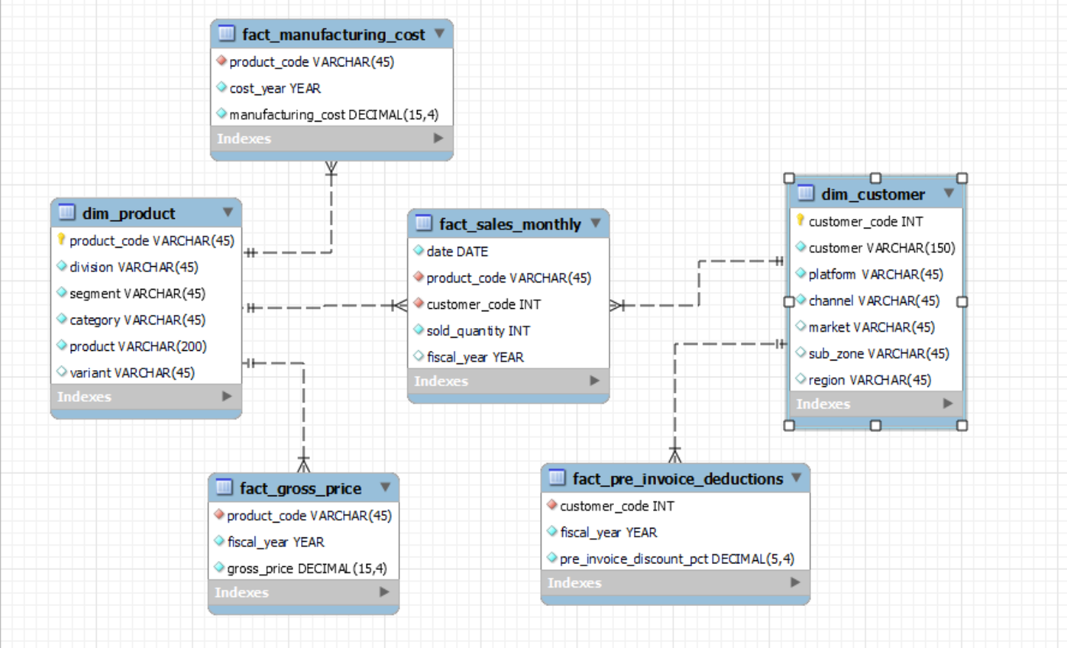
Data Model:

Slide 6
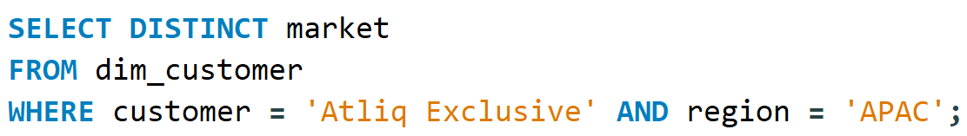
Request #1 Provide the list of Markets in which customer “AtliQ Exclusive” operates its business in APAC region

Slide 7
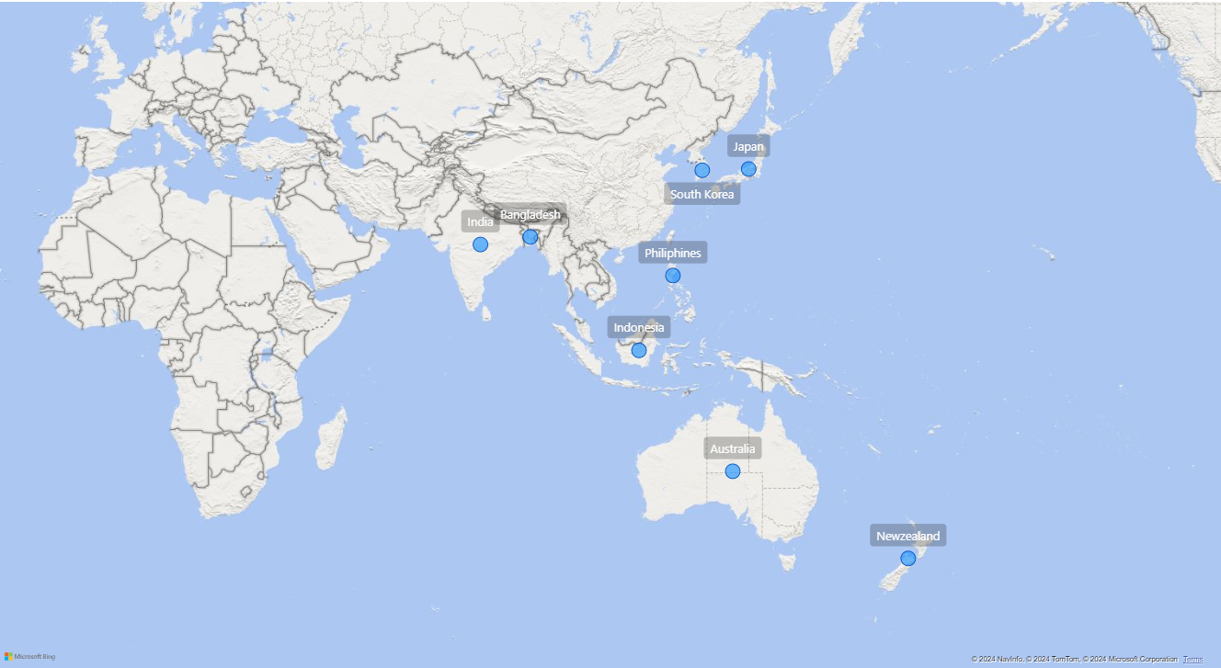
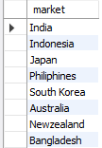
Output

Slide 8
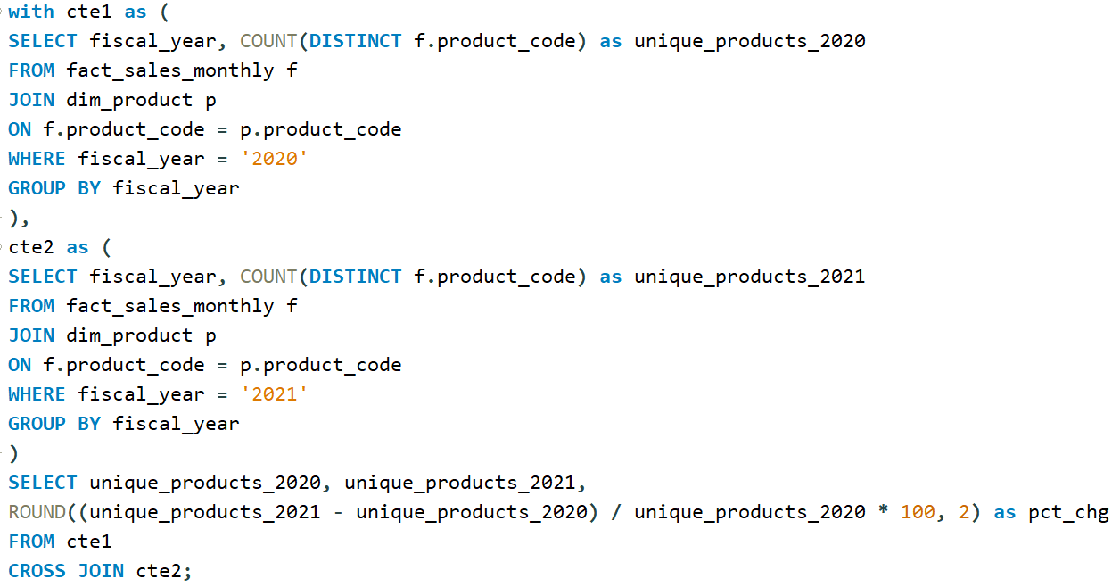
Request #2 What is the percentage of unique product increase in 2021 v/s 2020?

Slide 9

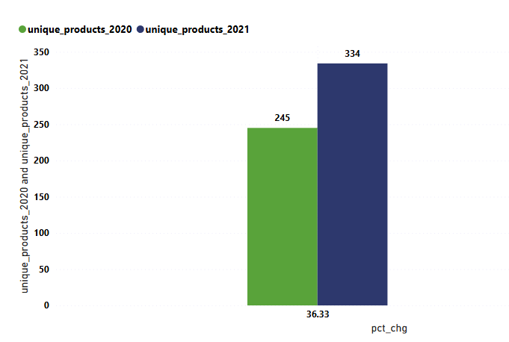
Output
The company had more unique products in 2021 than in 2020

Slide 10
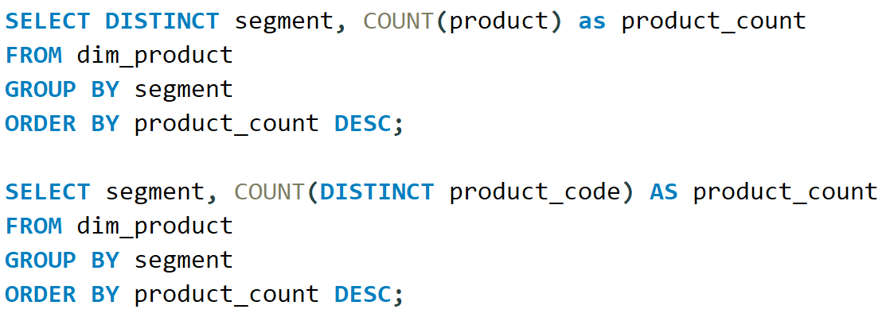
Request #3 Provide a report with all the unique product counts for each segment and sort them in descending order of the product counts.

Slide 11
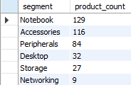
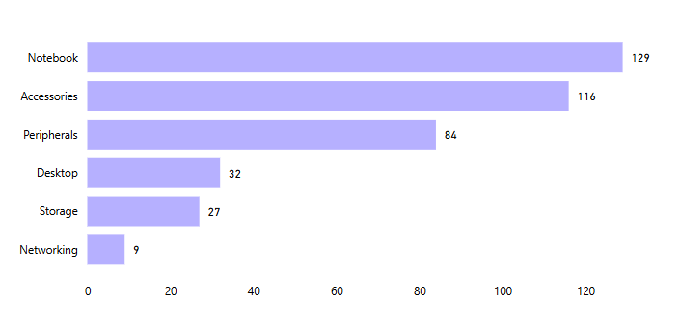
Output
Notebooks, Accessories and Peripherals contribute to 83% of the total Unique Product Count.

Slide 12
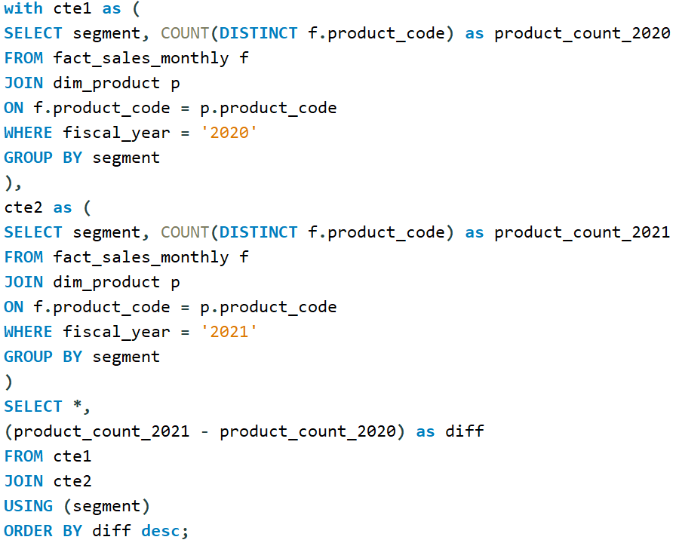
Request #4 Follow-up: which segment had the most increase in unique products in 2021 v/s 2020?

Slide 13
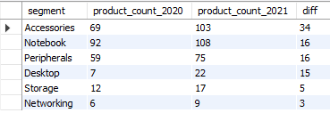
Output
Accessories, Notebook and Peripherals
had the most increase in unique product because of their higher manufacturing growth.

Slide 14
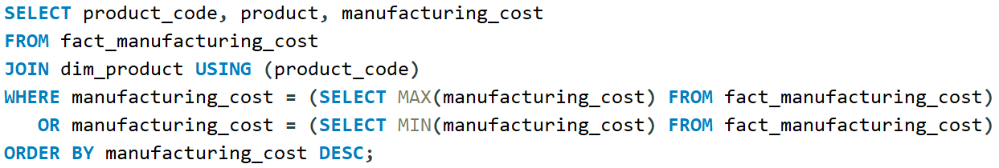
Request #5 Get the products that have the highest and lowest manufacturing costs

Slide 15
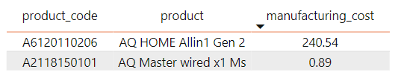
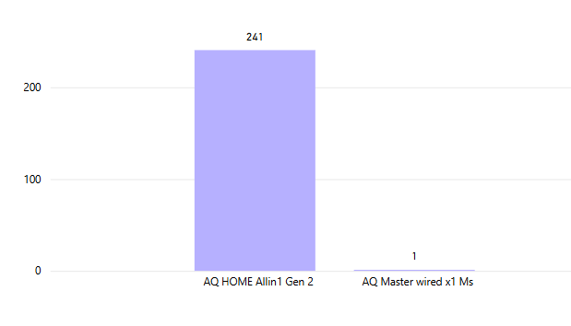
Output

Slide 16
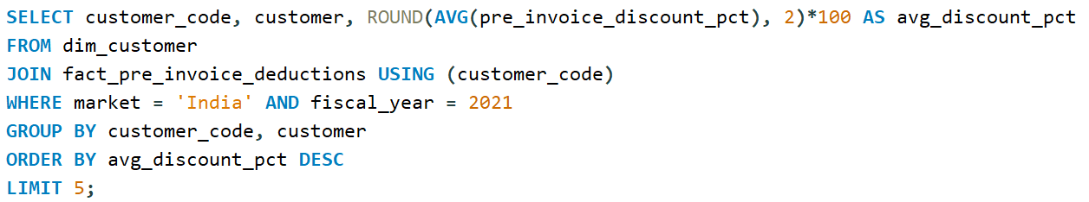
Request #6 Generate a report which contains the top 5 customers who received an average high pre_invoice_discount_pct for the fiscal year 2021 and in the Indian market

Slide 17
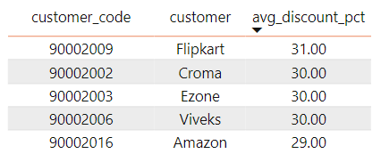
Output

Slide 18
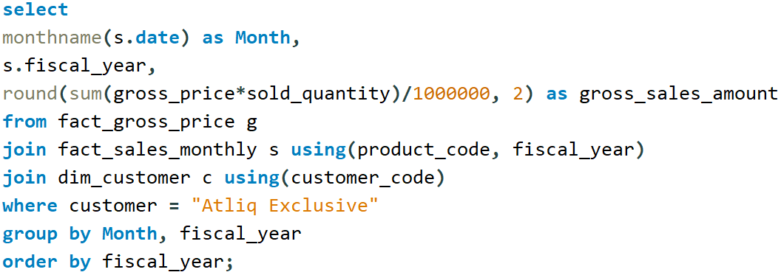
Request #7 Get the complete report of the gross sales amount for the customer “Atliq Exclusive” for each month.

Slide 19
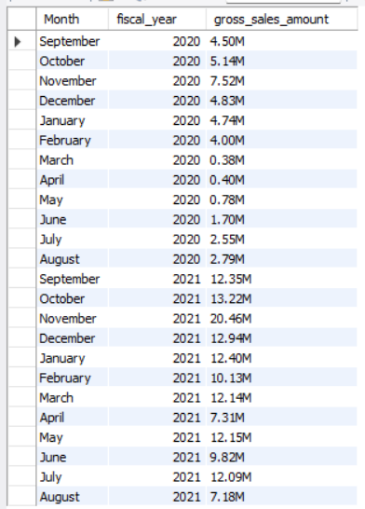
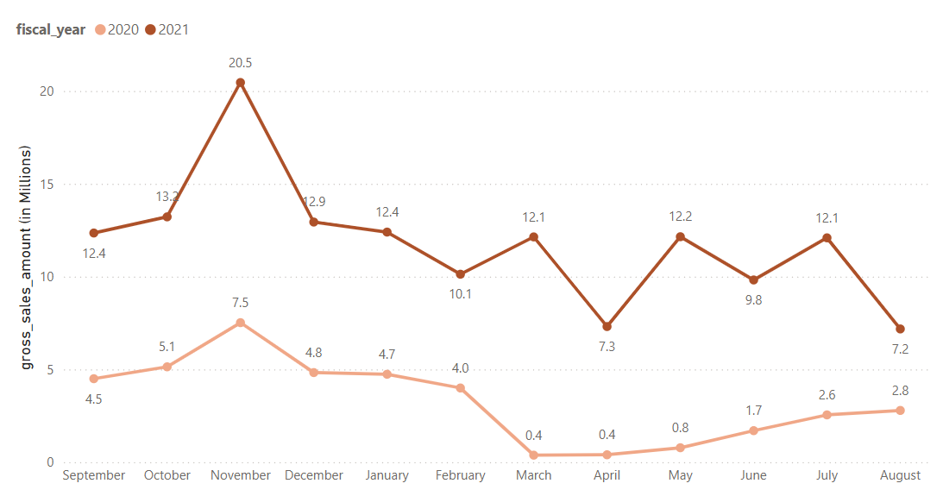
Output
The sudden drop in gross sales amount in March FY 2020 (from $4 Million to $0.4 Million ) was due to the start of the pandemic period of COVID-19 virus.

Slide 20
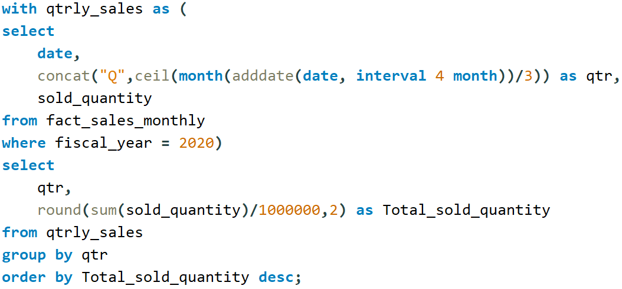
Request #8 In which quarter of 2020, we got the maximum total_sold_quantity?

Slide 21
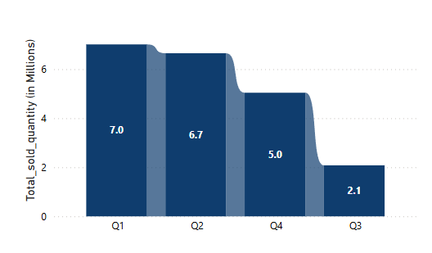
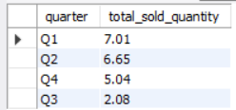
Output
-> Quarter 1 was the one with the highest total sold quantities(in millions)
of products in 2020.
-> Sudden drop in Quarter 3 of 2020 because of the lower manufacturing
growth due to COVID-19 pandemic.

Slide 22
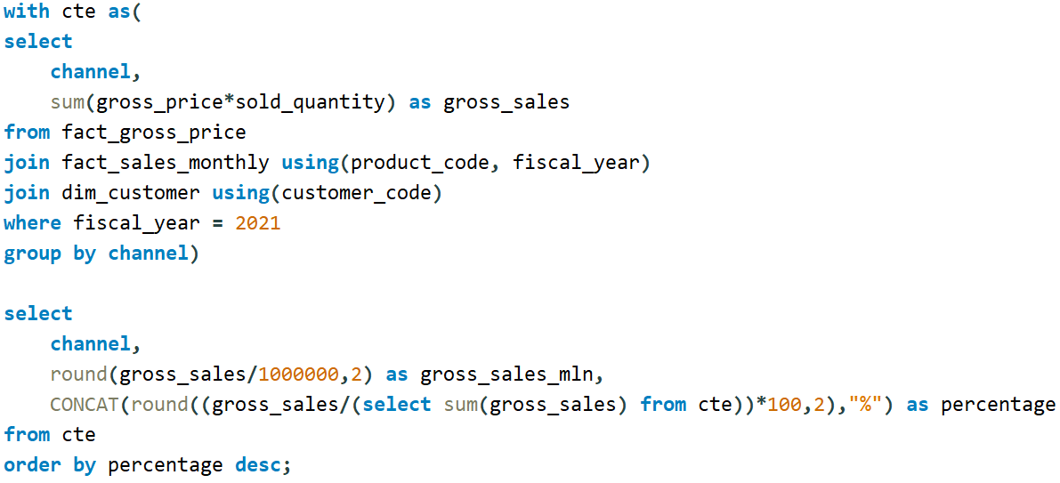
Request #9 Which channel helped to bring the most gross sales in fiscal year 2021?

Slide 23
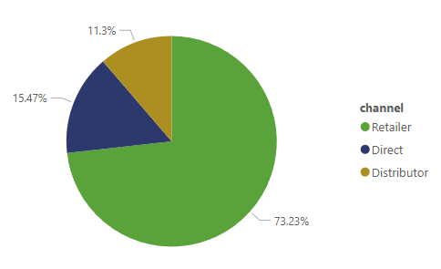

Output
Highest contribution by:
Retailers (73.22%)

Slide 24
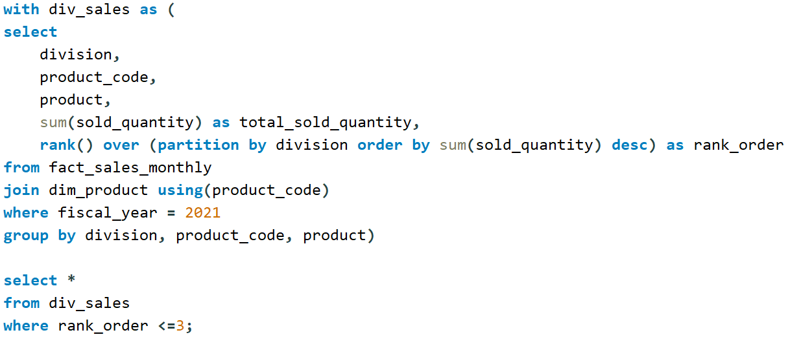
Request #10 Get the Top 3 products in each division that have a high total_sold_quantity in the fiscal year 2021

Slide 25
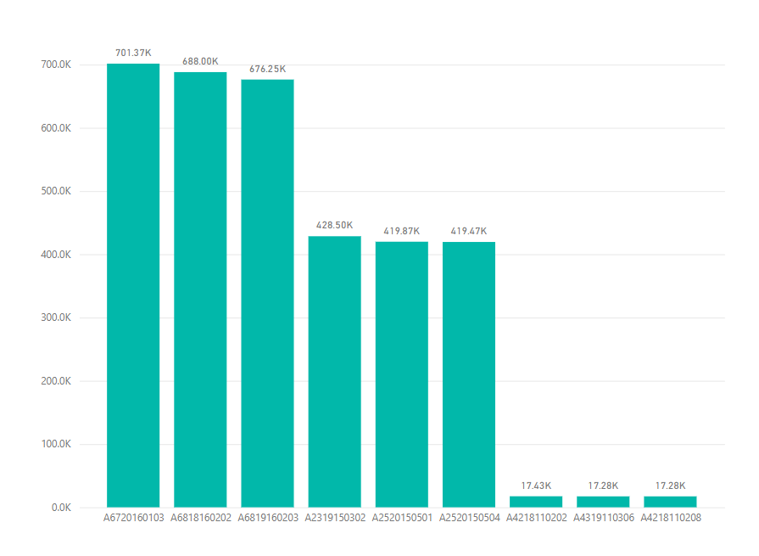
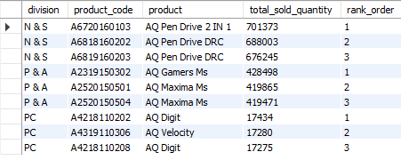
Output

Slide 26
Thank you!

